Slide 1
Module9 Family
Unit1 This is my mother.

Slide 2




Let’s say a chant.
Boy boy boy , this is a boy.
Girl girl girl , this is a girl.
Boy boy boy , this is a boy.
Girl girl girl , this is a girl.

Slide 3
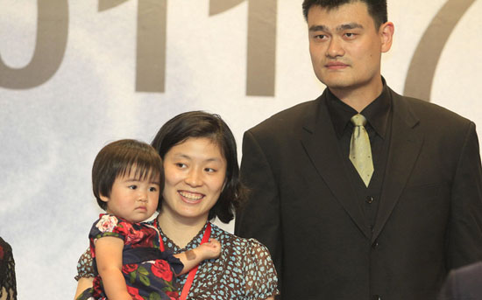
Yao ming’s family

Slide 4
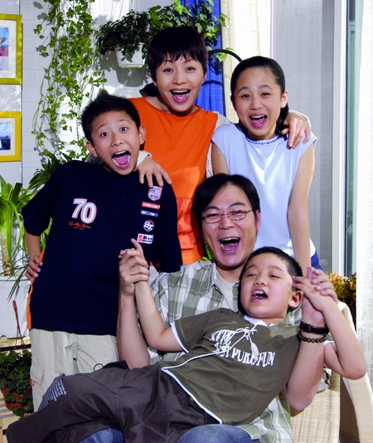
Liu xing’s family

Slide 5
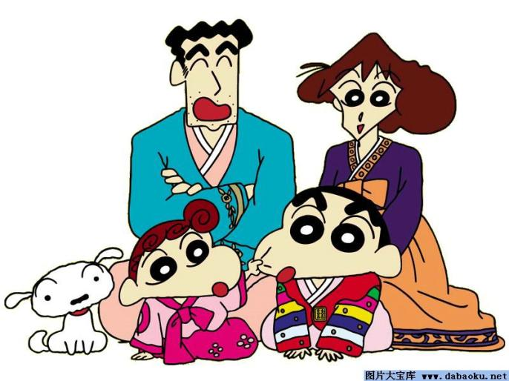
Xiaoxin’ s family

Slide 6
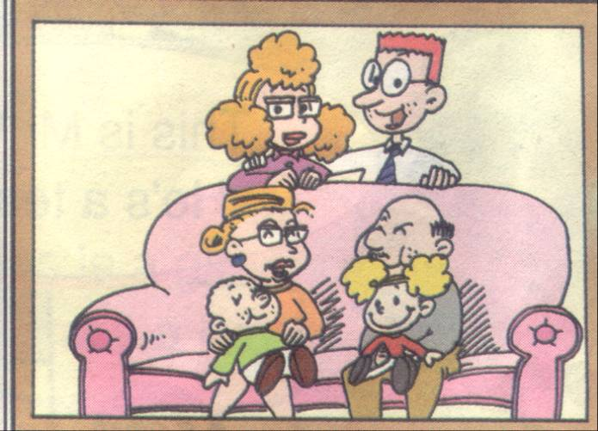
Sam’s family.

Slide 7
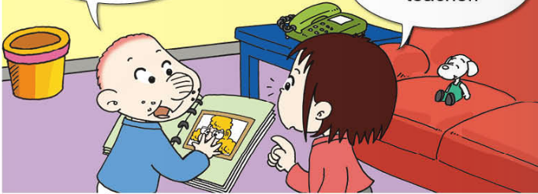
Sam如何向Lingling介绍他的家人？

Slide 8

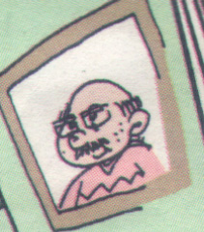
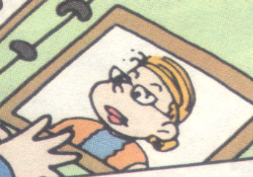
grandpa
grandma

Slide 9
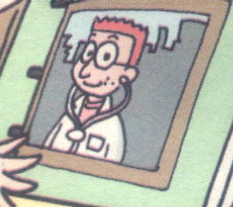
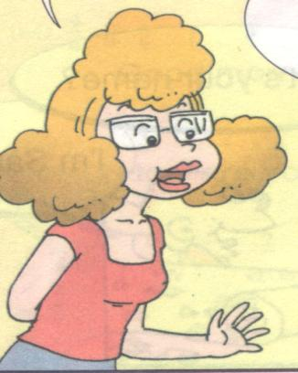
PPT模板：www.1ppt.com/moban/ PPT素材：www.1ppt.com/sucai/
PPT背景：www.1ppt.com/beijing/ PPT图表：www.1ppt.com/tubiao/
PPT下载：www.1ppt.com/xiazai/ PPT教程： www.1ppt.com/powerpoint/
资料下载：www.1ppt.com/ziliao/ 范文下载：www.1ppt.com/fanwen/
试卷下载：www.1ppt.com/shiti/ 教案下载：www.1ppt.com/jiaoan/
PPT论坛：www.1ppt.cn PPT课件：www.1ppt.com/kejian/
语文课件：www.1ppt.com/kejian/yuwen/ 数学课件：www.1ppt.com/kejian/shuxue/
英语课件：www.1ppt.com/kejian/yingyu/ 美术课件：www.1ppt.com/kejian/meishu/
科学课件：www.1ppt.com/kejian/kexue/ 物理课件：www.1ppt.com/kejian/wuli/
化学课件：www.1ppt.com/kejian/huaxue/ 生物课件：www.1ppt.com/kejian/shengwu/
地理课件：www.1ppt.com/kejian/dili/ 历史课件：www.1ppt.com/kejian/lishi/
father
mother
Notes:
PPT模板：www.1ppt.com/moban/ PPT素材：www.1ppt.com/sucai/
PPT背景：www.1ppt.com/beijing/ PPT图表：www.1ppt.com/tubiao/
PPT下载：www.1ppt.com/xiazai/ PPT教程： www.1ppt.com/powerpoint/
资料下载：www.1ppt.com/ziliao/ 范文下载：www.1ppt.com/fanwen/
试卷下载：www.1ppt.com/shiti/ 教案下载：www.1ppt.com/jiaoan/
PPT论坛：www.1ppt.cn PPT课件：www.1ppt.com/kejian/
语文课件：www.1ppt.com/kejian/yuwen/ 数学课件：www.1ppt.com/kejian/shuxue/
英语课件：www.1ppt.com/kejian/yingyu/ 美术课件：www.1ppt.com/kejian/meishu/
科学课件：www.1ppt.com/kejian/kexue/ 物理课件：www.1ppt.com/kejian/wuli/
化学课件：www.1ppt.com/kejian/huaxue/ 生物课件：www.1ppt.com/kejian/shengwu/
地理课件：www.1ppt.com/kejian/dili/ 历史课件：www.1ppt.com/kejian/lishi/

Slide 10
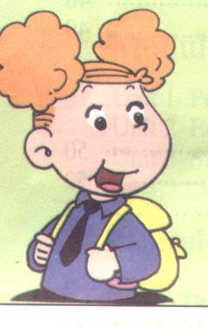
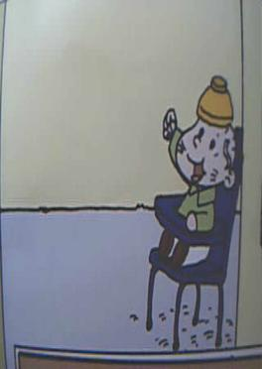
sister
brother

Slide 11
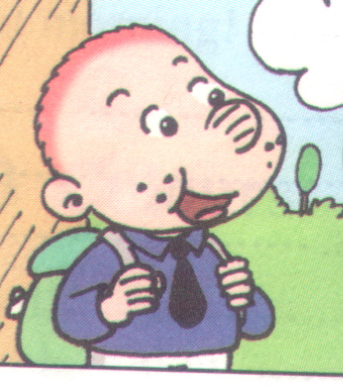
me
（我）

Slide 12
我会读
mother father grandpa grandma
母 亲 父 亲 祖父，外祖父 祖母，外祖母
sister brother me she he
姐 妹 兄 弟 我 她 他

Slide 13
read and answer
1. How many people are there in Sam’s family?
在萨姆的家里有多少人？
Seven .

Slide 14
read and answer
2.Who are they? 他们是谁？
They are Sam’s
father，
mother、
grandpa, grandma
sister,
brother and Sam.

Slide 15
read and answer
3、What does Sam’s mother do?(妈妈是做什么的？)
She’s a teacher.

Slide 16

she is a girl
He is a boy
她是一个女孩
他是一个男孩

Slide 17
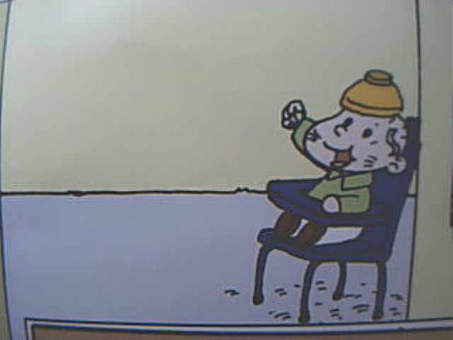

grandma
mother
grandpa
father
sister
brother

Slide 18

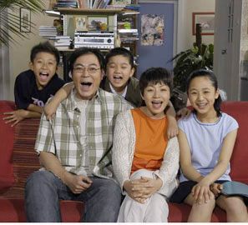
LiuXing’s family

Slide 19
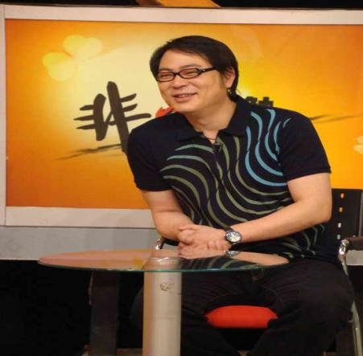
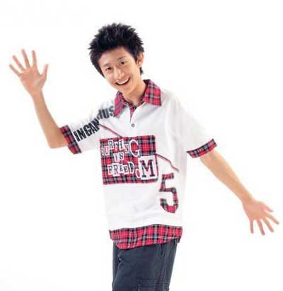
This is my
father

Slide 20
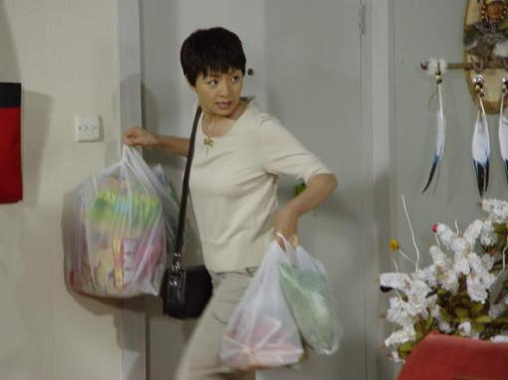
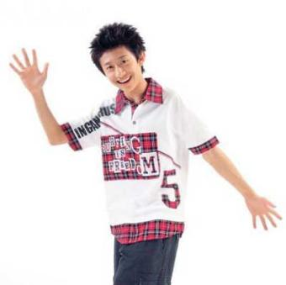
This is my
mother

Slide 21
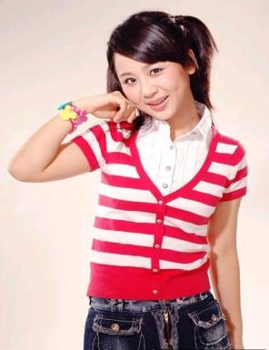
This is my
sister

Slide 22
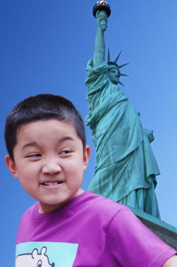
This is my
brother

Slide 23
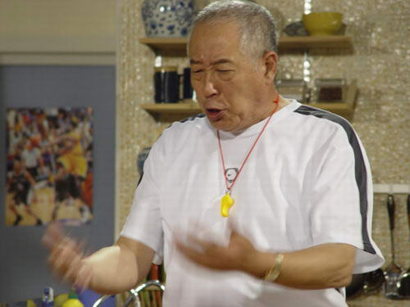
This is my
grandpa

Slide 24
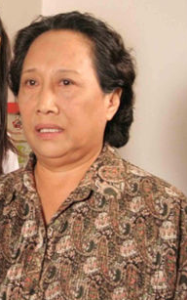
This is my
grandma

Slide 25
That’s me.

Slide 26
Let’s play
a game
看谁的眼睛最亮

Slide 27

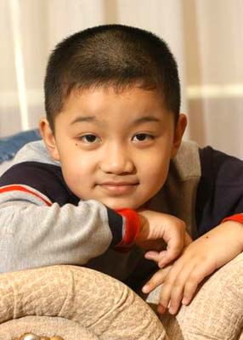

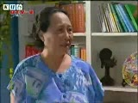


Slide 28




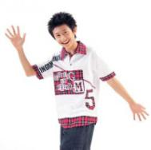

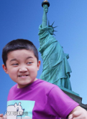
family
tree

Slide 29

f
a
m
i
l
father
and
mother
y
I
love
you

Slide 30
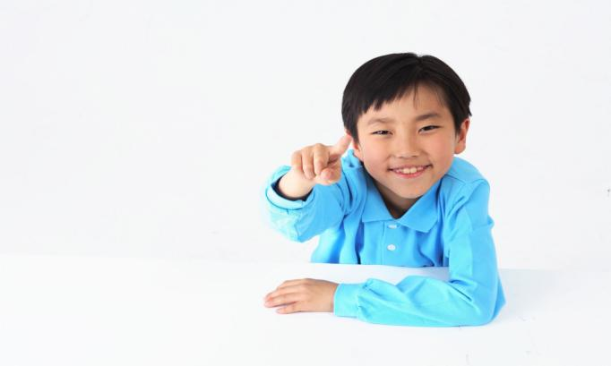
Can you guess?
Is this a……..? Yes,it is./No,it isn’t.

Slide 31

Can you guess?
Is this a……..? Yes,it is./No,it isn’t.

Slide 32

Can you guess?
Is this a……..? Yes,it is./No,it isn’t.

Slide 33
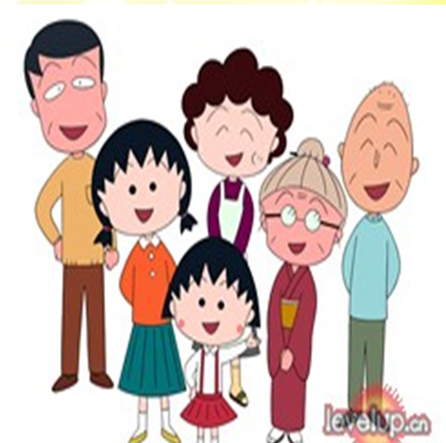
Introduction(介绍）
Hello! I’m .
This is my .
She’s a ,
This is my .
He’s a . ……..
（teacher/doctor）
I love my family
doctor
teacher
farmer

Slide 34
Homework
1.回家后为爷爷奶奶或是父母做一件自己力所能及的家务事，以自己的行动回报他们的爱。
2.周末就近进行一次互访活动，运用本节课所学句式向自己的伙伴介绍自己的家人。

